Slide 1
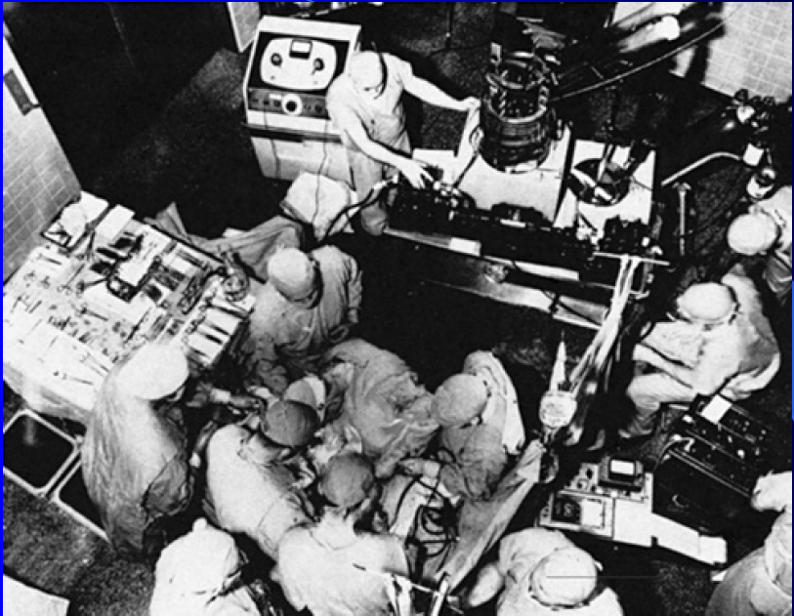

Slide 2
PRINCIPLES OF
SURGERY OF COMPLEX CYANOTIC
CONGENITAL HEART DISEASE
Dr.Divya E M

Slide 3
Introduction
Knowledge concerning congenital defects of the heart can be traced as far back as Aristotle in the fourth century BC
Paget, 1896 Surgery of the chest - “Surgery of the heart has probably reached the limits set by nature to all surgery: no new method and no new discovery can overcome the natural difficulties that attend a wound of the heart.”

Slide 4
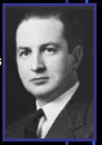
R. Gross – first PDA ligation – March 6, 1937
J. Gibbon – first succesful ASD closure using heart/lung machine – May 6, 1953 – next 2 patients died – moratorium on surgical repair

Slide 5
By 1950 some forms of surgical palliation for congenital heart disease were firmly entrenched
The introduction of cardiopulmonary bypass in the mid 1950 and deep hypothermia with circulatory arrest in the early 1970s provided the platform for intracardiac repair of most congenital cardiac conditions amenable to repair

Slide 6
Operations for congenital heart disease
May be classified as
Palliative- relieving the symptoms of the heart disease
Reparative or corrective - obtaining normal heart function

Slide 7
Anatomically corrective
Make heart structures normal
Physiologically corrective
Separate and/or redirect the blue and pink blood circulations
These corrective procedures range from
simple- closing or patching a hole or tying off a vessel
complex- as switching vessels or rerouting blood streams
Notes:
Most corrective
operations require the use of a heart-lung machine, a cardio-pulmonary bypass
pump. Some corrective surgical procedures provide complete correction of the
normal physiology of the heart. Some corrective procedures provide an altered type
of physiology of the heart and provide permanent palliation, such as the Fontan procedure

Slide 8
Palliative procedures
Palliative operations are performed to improve the heart function usually in children too young for corrective surgery
The aim is to
Lessen cyanosis
Control heart failure
Prepare the circulation for later repair
Notes:
improve but not correct an abnormal heart function
Few heart operations are truly corrective; usually some lifetime follow up is required.
Most surgeries can restore the heart and vessels to near normal performance and
extend the life span

Slide 9
21 palliative procedures in total
categorized into four classes
  Increasing pulmonary artery flow for pulmonary oligaemia
    Shunt procedures
  •Decreasing pulmonary artery flow for pulmonary overcirculation
    Pulmonary banding and Norwood procedure
  • Enhancing intracardiac blood-oxygen mixture for systemic hypoxaemia
    Atrial septostomy
  • Other procedures
    Congenital MS , AS , COA ,HLHS palliation procedures

Slide 10
A median sternotomy is the approach used for the majority of corrective congenital cardiac surgical procedures
In children
- relatively pliable bones and ligaments
- hence median sternotomy is associated with little
postoperative pain or later deformity
Notes:
Although this approach requires an incision along the length of the sternum, there is no cutting or stretching of muscles, with the majority of the motion occurring at the costovertebral junctions (1). In adults, sternal closure is typically achieved with nonabsorbable sutures, including stainless steel wire. Because of potential problems with bone growth and healing in the pediatric population, radiolucent synthetic absorbable suture material is now most commonly used

Slide 11
Palliative Surgery
Systemic – pulmonary artery shunt
Blalock-Taussig shunt
Unifocalization and shunt
Cavopulmonary shunt (BCPS)
RVOT reconstruction
Valvotomy
Patch widening
Valved conduit
Pulmonary artery banding
Atrial septectomy

Slide 12
Palliative procedures
  systemic-to-pulmonary artery shunt
  11 shunt procedures in total
    Attributes of an ideal shunt
      Technical simplicity
      Good functionality
      Good long-term patency
      Easy takedown before repair
      No residual shunt after closure
Notes:
has been used for many years to establish unobstructed systemic blood flow, normalize pulmonary blood flow and pressure and relieve pulmonary venous obstruction
The indications for a systemic-to-pulmonary artery shunt include tetralogy of Fallot, tricuspid atresia, pulmonary atresia with intact ventricular septum, pulmonary atresia and ventricular septal defect, Ebstein’s anomaly, single ventricle situation with pulmonary or aortic atresia and hypoplastic left heart syndrome (HLHS)

Slide 13
Systemic–Pulmonary Artery Shunt
Complex anomaly with-
Severe cyanosis, irritability,hypoxic episode
Critically ill neonates or infants due to
Decreased pulmonary flow
Facilitating growth of hypoplastic pulmonary artery

Slide 14
Palliative Procedures
Classic and Modified BT Shunts
The original BT shunt was designed as a palliative procedure to increase pulmonary blood flow for the relief of cyanosis
Described in May 1945, the BT shunt was developed by Alfred Blalock,a pioneer in general and cardiothoracic surgery, with support from pediatric cardiologist Helen B. Taussig and surgical technician Vivien Thomas

Slide 15
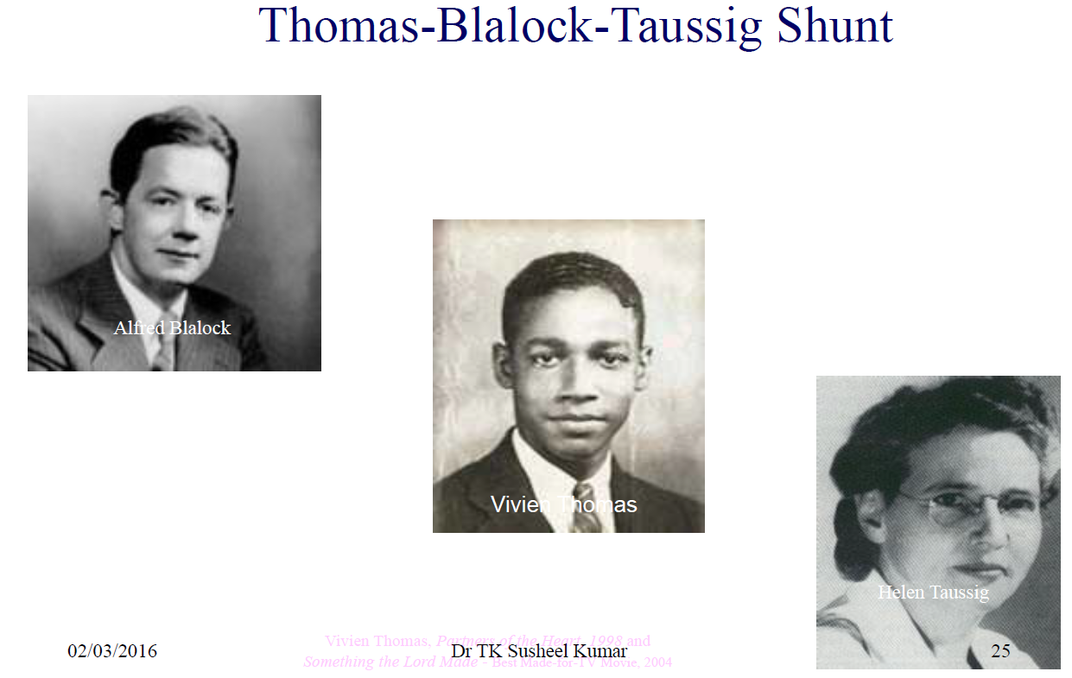

Slide 16
Classic Blalock-Taussig’s shunt
Direct anastomosis between the transected subclavian artery (or the innominate artery) and the pulmonary artery
Notes:
does not require prosthetic material and offers the theoretical possibility for growth but requires extensive surgical dissection and sacrifices the subclavian artery

Slide 17
Disadvantages of classic shunts
Long operative dissection time
Phrenic nerve injury
Technical difficulties during takedown and possible arm ischaemia
Shunt distortion
  Explained by the failure of the anastomosis to grow
  Effects of the scar tissue around the suture material
Notes:
. When classic shunts are performed, it is usually reported that they should be constructed on the side opposite to the aortic arch to avoid pulmonary artery kinking.
Better understanding of the condition led to a revolution in the surgical technique for the Blalock-Taussig’s shunt: an interposed graft (prosthetic or human vascular) was used between the subclavian and pulmonary arteries [8]; this is called a modified Blalock-Taussig’s shunt (Fig. 2).

Slide 18
Modified Blalock-Taussig’s shunt
Involves interposing a prosthetic graft of polytetrafluoroethylene between the subclavian artery and ipsilateral right or left PA

Slide 19
Benefits of the modified BT shunt
Technical ease of the procedure
  Can be performed on either side of the aortic arch
Wide anastomoses proximally and distally
Preserved blood flow to the ipsilateral arm
Notes:
The modified BT shunt is currently used for palliation prior to complete repair of a lesion, as an adjunct to the repair of single-ventricle palliations, and in patients with inadequate pulmonary blood flow who are otherwise not amenable to primary complete repair

Slide 20
BDG shunt and atrial septectomy in TA with VSD

Slide 21
Complications
Thrombosis of a modified BT shunt
Subtotal occlusion or stenosis of a BT shunt
  Management
    Shunt revision
    Balloon angioplasty and stent placement has been described
Seroma
Notes:
is not uncommon and may be life threatening.
Although usually a late complication(occurring months to years after shunt creation), thrombosis can occur in the early postoperative period as well. Diagnosis can often be made with the aid of echocardiography but can also be made with CT angiography and MR imaging
A well-recognized, but also uncommon complication of the modified BT shunt is adjacent to the shunt. This is caused by seepageof fluid across the polytetrafluoroethylene graft. If large enough, the seroma can cause symptoms of airway compression or pericardial tamponade (15). The presence of a seroma is suggested by a mediastinal mass seen on chest radiographs, with the differential diagnosis including mediastinal hematoma. The diagnosis of a seroma, although usually made with the aid of echocardiography, can be made with the CT demonstration of a low attenuation cystic mass in the mediastinum (16). US-guided percutaneous drainage of these seromas has been described in symptomatic patients, eliminating the need for emergent surgical revision

Slide 22
Central shunt
An anastomosis between the ascending aorta and the main pulmonary artery
Made of prosthetic or other materials
Also known as the Mee’s shunt
The internal mammary artery is used to create a systemic-to-pulmonary artery shunt after failure of a previous Blalock-Taussig’s shunt
Notes:
The internal mammary artery is used to create
a systemic-to-pulmonary artery shunt after failure of
a previous Blalock-Taussig’s shunt; this offers the advantage
of growth and flow adaptation, eliminates the risk of
prosthetic graft infection and does not affect blood flow
to the arms [11]. The advantages of this technique are its
applicability in small children with small peripheral vessels,
prevention of distortion of pulmonary arteries, provision of
equal pulmonary blood flow to both lungs, lower occlusion
rate, avoidance of subclavian artery steal and ease of closure
during corrective repair. The primary disadvantages are
entry into the pericardium and inapplicability in patients
without a patent ductus arteriosus or other source of pulmonary
blood flow.

Slide 23
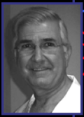
Glenn shunt - cavopulmonary shunt
First used clinically by
William W.L. Glenn in 1958
Notes:
consists of an end-to-end anastomosis of the right PA (divided from the main PA) to the side of the SVC
The SVC is ligated at its entrance to the right atrium, directing all proximal SVC blood flow to the right PA
The azygos vein is also ligated
The shunt was intended to palliate congenital heart defects in which there was hypoplasia or atresia of rightsided structures of the heart—conditions such as tricuspid atresia, Epstein anomaly, and pulmonary atresia with intact ventricular septum
These patients typically have low pulmonary vascular resistance, which allows deoxygenated blood from the SVC to passively perfuse the pulmonary circulation without the assistance of the heart

Slide 24
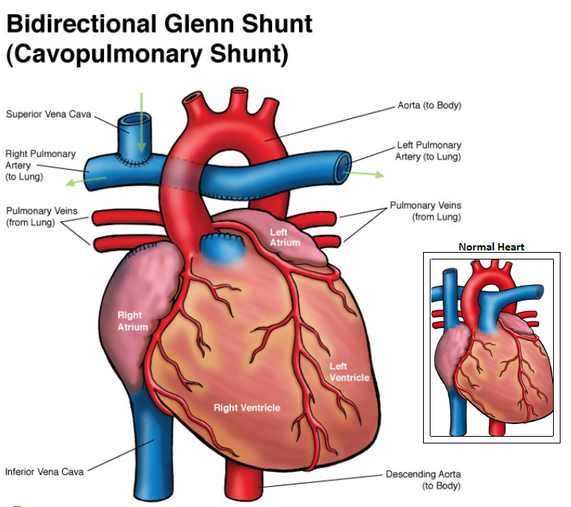
BDG Shunt
Performed by connecting the superior vena cava to the right pulmonary and by dividing or tying up the pulmonary artery
Decreases volume load on the single ventricle while improving oxygen saturation
Notes:
The bidirectional Glenn’s shunt is preferred in very small babies
In whom lung vessel resistance is still quite high
Avoids the risk of failure of a complete Fontan operation
relieves symptoms partly

Slide 25
Progressive cyanosis
  Due to the development of systemic venous collaterals that decompress the superior caval system into the inferior caval system
  Formation of a diffuse arteriovenous shunt not amenable to coil embolization

Slide 26
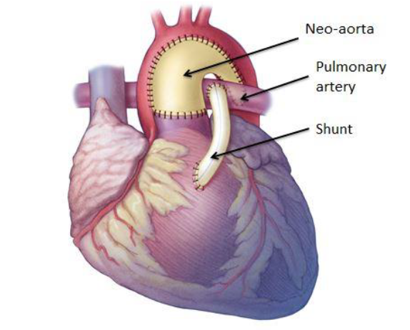
Sano’s shunt
Right ventricle to pulmonary artery conduit
Referred to as the Sano modification of the Norwood procedure
Allows blood to be pumped directly to the lungs
Greater haemodynamic stability noted with Sano modification than with BT shunt

Slide 27
‘‘Wanna-be’’ Blalock-Taussig’s shunt
Ruiz and Bailey named ductus arteriosus stenting a ‘‘wanna-be’’ Blalock-Taussig’s shunt
Ductus stenting in neonates and infants with duct-dependent cyanotic congenital heart disease
Eliminated the need for palliative surgery
No risk of serious complications or pulmonary artery distortion and stenosis
Gains time for the child and the pulmonary arteries to grow
Leaves the operative field for definitive surgery untouched

Slide 28
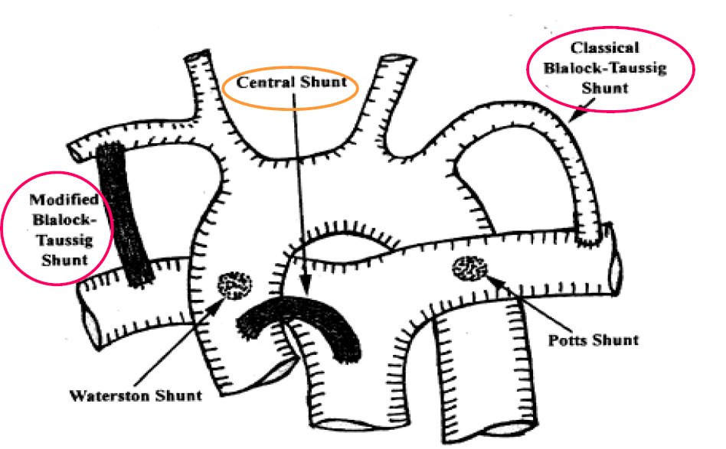
Other shunts
The Potts’s (Potts-Smith-Gibon) shunt
  Connection between the descending aorta and the left pulmonary artery
The Waterston-Cooley’s shunt
  Side-to-side anastomosis between the ascending aorta and the right pulmonary artery
  Extrapericardial [Waterston]
  Intrapericardial [Cooley]
Notes:
This shunt was abandoned because of the high incidence of subsequent pulmonary hypertension, the preferential blood flow to one lung with kinking and distortion of the pulmonary artery and the technical difficulties with takedown.
which is indicated for tetralogy of Fallot. Because of complications (including preferential distribution of most or all shunt flow to the right lung, narrowing or obstruction of the right pulmonary artery at the anastomotic site, increasing stenosis or atresia of the right ventricular outflow tract,hypoplasia of the left pulmonary artery and obstruction of the shunt itself with the Waterston’s shunt [18]) and a similar mortality rate to that for the Blalock-Taussig’s shunt,it has been largely abandoned and substituted by the latter,except in infants aged less than 2 weeks [19]. It has been recognized that the Waterston-Cooley’s shunt is oftencomplicated by pulmonary overcirculation, left ventricular failure and pulmonary microvascular hypertension [20]. It is technically difficult to close this shunt properly at the time of total correction. Most surgeons have abandoned the Waterston-Cooley’s shunt.

Slide 29
Pulmonary artery banding
First described by Muller and Dammann in 1951
‘‘creation of pulmonary stenosis’’ in a 5-month-old infant with a large VSD and pulmonary overcirculation
Preferred method of palliation in CHD characterized by left-to-right shunting and pulmonary overcirculation
Indicated in TGA for rapid ventricular retraining
Notes:
This technique has been broadened to treat congestive heart failure caused by large ventricular septal defects, atrioventricular canal defects and tricuspid atresia
Contraindicated
Significant subaortic obstruction
Single ventricle defects in which the aorta arises from an outflow chamber
Truncus arteriosus

Slide 30
Complications of PA banding
Dilatation of the proximal portion of the PA with resultant valve insufficiency
Pulmonary valve injury - If placed too close to the pulmonary valve
Compromised blood flow through the Pas
- If the band migrates distally- particularly the right PA

Slide 31
Atrial septostomy
Blalock-Hanlon operation
  Atrial septectomy without cardiopulmonary bypass
Rashkind procedure
  Balloon catheter atrial septostomy

Slide 32
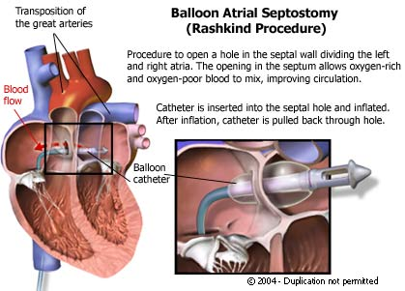

Slide 33

Complex Repairs
Fontan Operation: Total Cavopulmonary Connections
First described by Fontan and Baudet in 1971
Initially for repair of tricuspid atresia
Has been applied to all types of single ventricle anatomy
  Tricuspid atresia, single-ventricle syndromes (hypoplastic left heart syndrome,hypoplastic right ventricle with pulmonary atresia, and double-inlet ventricle),and heterotaxy syndromes
Notes:
Prior to the advent of surgical palliation most children with tricuspid atresia had a very poor prognosis with most dying early in life. In 1971 Fontan and Baudet, building on Glenn’s advances in the late 1950s, described a corrective procedure that they used on three children. Over the subsequent decades the Fontan procedure was transformed from a single surgical procedure into a multistage process, with several slightly differing approaches
Furthermore the number of conditions corrected by using this procedure has increased, now including tricuspid atresia, single-ventricle syndromes (hypoplastic left heart syndrome,hypoplastic right ventricle with pulmonary atresia, and double-inlet ventricle),and heterotaxy syndromes
Often performed at 18 months to 4 years of age

Slide 34
Principle of the Fontan circulation
The pulmonary circulation can be perfused without a ventricular pump
Separates the systemic and pulmonary circulations to achieve normal (or near normal) oxygen saturations
Decrease the volume load on the single ventricle
The single ventricle becomes the systemic pump
The pulmonary circulation receives passive nonpulsatile blood flow directly from the vena cava (SVC and IVC), without a ventricular pump
Notes:
If pulmonary artery pressure is normal, the systemic venous pressure in the vena cava is able to exceed pulmonary artery resistance to allow forward flow into the pulmonary arteries

Slide 35
The goal of the original surgery was to provide physiologic correction of blood flow
Notes:
To accomplish this Fontan and colleagues initially used a classic Glenn cavopulmonary shunt, in which the distal end of the divided right PA was connected to the SVC and the cavoatrial junction was ligated
In addition they closed the atrial septal defect and created an extracardiac valved-conduit connection between the right atrium and the left PA, using homograft material to bridge the gap and provide the valves. The overall result was SVC blood directly entering the right pulmonary circulation and IVC blood directly entering the left
Multiple variations followed all using the right atrium as a conduit for blood flow to the PAs. It was thought that incorporation of the atrium into the Fontan circuit would result in improved pulmonary blood flow with atrial contraction. Ultimately, the atrium enlarged and dilated, losing contractile function and actually impeding pulmonary blood flow

Slide 36
Currently Fontan circulation accomplished by using a BDG shunt to direct SVC blood to the lungs and a tunnel (lateral tunnel Fontan) or conduit (extracardiac conduit Fontan) to direct blood from the IVC to the lungs
Notes:
With the lateral tunnel Fontan, a tunnel is created within the right atrium by using prosthetic material
The inferior aspect of the tunnel is anastomosed to the IVC, and the superior aspect is anastomosed to the Pas
Blood flow from the IVC is thus directed through the right atrial tunnel, exiting the superior aspect into the right PA
With an extracardiac conduit Fontan, the IVC is separated from the right atrium
A polytetrafluoroethylene tube graft is created from the IVC to the right PA beside the right atrium, rather than within it
With either procedure, a small opening or fenestration may be created between the venous pathway and the atrium, which acts as a “pop-off” valve to prevent rapid volume overload to the lungs. Both techniques result in smooth laminar flow through the Fontan circuit into the PAs with minimal loss of energy

Slide 37
Hemi-Fontan procedure
Consists of a BDG shunt with a second connection
Cardiac end of the divided SVC is also attached to the right or main PA
This anastomosis is temporarily oversewn or occluded by a polytetrafluoroethylene patch
Notes:
The hemi-Fontan approach allows easier conversion to the modified Fontan procedure at a later time, which is accomplished by excising the patch or opening the anastomosis and then connecting this anastomosis to the IVC with a conduit or tunnel

Slide 38
Complications
Formation of pulmonary arteriovenous malformations
Protein-losing enteropathy
Elevated systemic or right atrial pressure
Thrombosis in the right side of the heart and the Fontan tunnel or conduit
Effusions
Arrhythmias
Progressive exercise intolerance
Anastomotic stenosis
Hepatomegaly
Notes:
Despite the many advances described above, there are several well documented complications associated with the Fontan procedure.

Slide 39
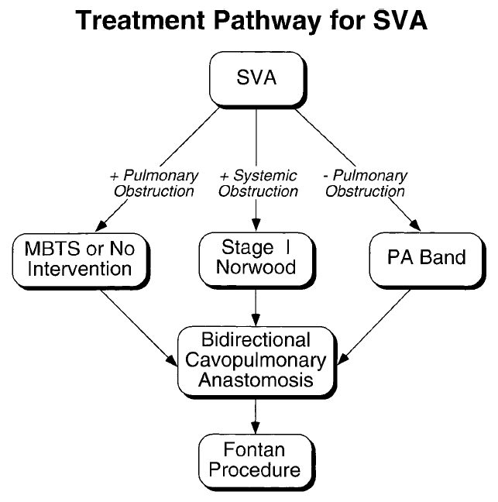

Slide 40
Norwood Procedure
Described by William Norwood Lang and Hansen (1983)
Consists of a three-stage surgery
Create a new functional systemic circuit in patients with hypoplastic left heart syndrome
Notes:
Since that time several modifications have been implemented to improve patient morbidity and mortality

Slide 41
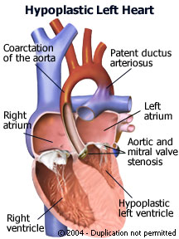
Hypoplastic left heart syndrome
Multiple levels of stenosis or hypoplasia of left sided structures
Aortic stenosis or atresia and mitral stenosis or atresia
Ascending aorta and transverse aortic arch are hypoplastic and there is COA
Systemic circulation dependent on PDA
Notes:
Prior to the inception of the Norwood
procedure, hypoplastic left heart
syndrome was nearly always fatal, accounting
for about 25% of early cardiacrelated
deaths (40,45).

Slide 42
The high neonatal pulmonary vascular resistance precludes definitive repair of HLHS in the newborn
Thus a staged surgical approach used to transition the infant to definitive repair
The overall goals of the procedure are
  Utilize the right ventricle as the systemic arterial pump
  Ensure unobstructed pulmonary venous return to the right side of the heart, and
  Reroute systemic venous return to the lungs- restoring the “in series” circulation

Slide 43
Stage 1: Norwood procedure
The first stage performed within the first few days of life
The goals of the first stage of the Norwood procedure are
  Establish a permanent unobstructed connection between the right ventricle and the systemic arterial circulation
  Ensure unobstructed pulmonary venous return with a satisfactory interatrial communication (atrial septectomy)
  Provide stable but limited pulmonary blood flow via a systemic-topulmonary shunt

Slide 44
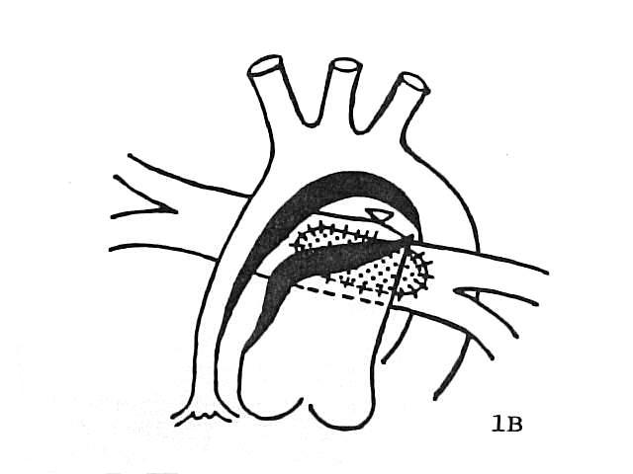
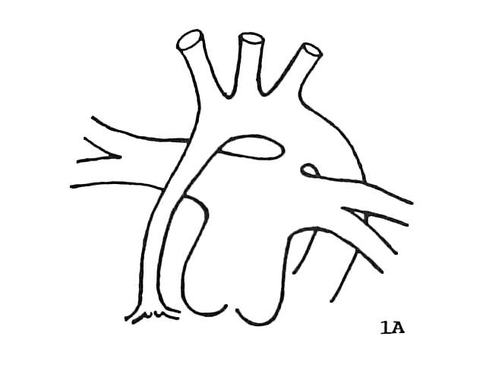
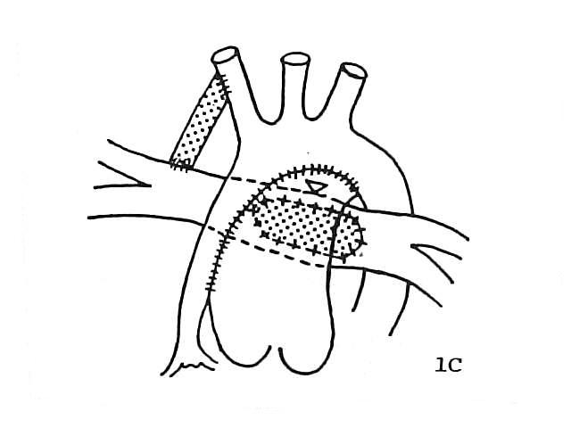
Notes:
The first goal of making the right ventricle the systemic pump is accomplished by reconstructing the aorta by using the main PA
After dividing the main PA at the level of the bifurcation, a side-to-side amalgamation is created between the main PA and the hypoplastic aortic arch (with its coronary arteries
The areas of hypoplasia and coarctation of the transverse aorta are augmented with a prosthetic patch creating an unobstructed single arterial trunk that leaves the heart
The second goal of the operation is to relieve any obstruction of pulmonary venous return, which must pass through an atrial septal defect to enter the right ventricle
To avoid any obstruction at this level, the atrial septum is excised
In addition the patent ductus arteriosus is ligated
Because the main PA is used to augment the ascending aorta in the first stage of the Norwood procedure, a new source of pulmonary blood flow in a neonate with elevated PA pressures is necessary
Therefore, a stable source of pulmonary blood flow is provided by either a modified BT shunt or a right ventricle–to-PA (Sano) shunt
A less commonly used alternative consists of a central shunt from the underside of the reconstructed aorta to the confluence of the Pas

Slide 45
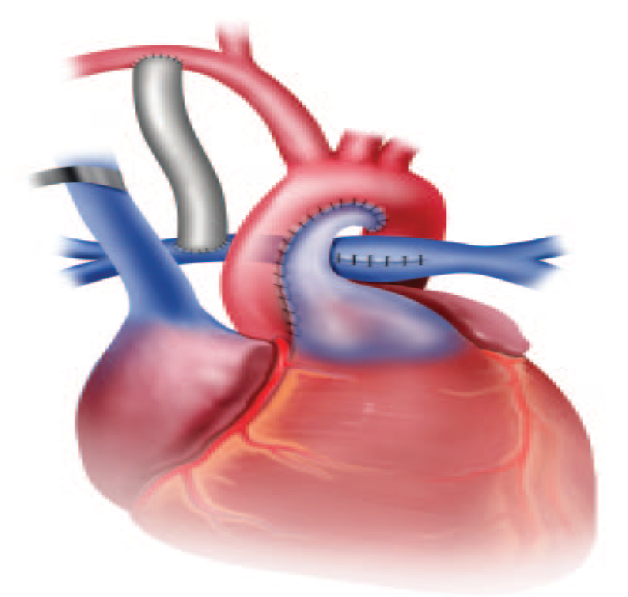
stage 1 of the Norwood
Notes:
The end result of the first stage of the Norwood procedure is that the right ventricle pumps admixed blood to the systemic and coronary arteries via the reconstructed aorta
Blood from the hypoplastic left heart passes to the right side of the heart via the atrial septal defect
Blood is delivered to the Pas through the modified BT shunt (or equivalent approach)
The common atria receive systemic blood from the IVC and SVC and pulmonary blood from the pulmonary veins

Slide 46
Norwood procedure with Sano modification (right ventricle–to-PA conduit)
Notes:
Advantages
Improved coronary perfusion
Higher diastolic pressure
Narrowed pulse pressure
Lower pulmonary to systemic ratio
Pulsatile pulmonary blood flow
Improved end-organ perfusion
Disadvantages
Right ventriculotomy
Arrhythmias
Right ventricle dysfunction
Right ventricle aneurysm
Tricuspid valve dysfunction
Early or progressive hypoxemia
Increased volume load on right ventricle
Inadequate pulmonary artery growth
Shunt stenosis/thrombosis

Slide 47
stage 2 of Norwood procedure. BT shunt has been replaced with Glenn
Notes:
The second stage of the Norwood procedure is generally performed when pulmonary vascular resistance has decreased to normal levels and the SVC is large enough to provide adequate pulmonary blood flow
Typically around 3–6 months of age
The goal is to begin to separate the systemic and pulmonary circulations
This is accomplished by creating a cavopulmonary shunt, either a BDG anastomosis or a hemi-Fontan operation
The modified BT shunt is also eliminated
This results in decreased volume load on the single ventricle

Slide 48
Stage 3: modified Fontan procedure
(b) Fontan extracardiac conduit (Norwood procedure, stage 3)
(a) fenestrated Fontan lateral tunnel (Norwood procedure, stage 3)
Notes:
The third and final stage of the Norwood procedure completes the separation of the pulmonary and systemic circulations and places the circulations back in series
Either a lateral tunnel Fontan or an extracardiac conduit Fontan is created to divert flow from the IVC to the PAs
Now all the systemic venous return is separated from the pulmonary venous return thereby eliminating cyanosis
The SVC empties into the PAs via the BDG shunt created during stage 2 the IVC blood flow passes directly to the PAs through the modified Fontan conduit and the pulmonary veins remain attached to the surgically created common atria

Slide 49
Complications
Pleural effusions often right sided
Pericardial effusions and ascites are also seen
Increased right atrial pressure -result in hepatomegaly or SVC syndrome
Other long-term complications
  protein-losing enteropathy and heart failure

Slide 50
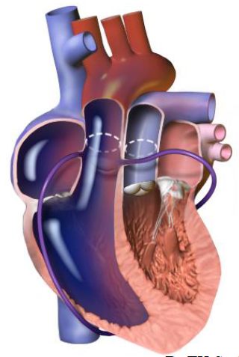
Dextro-TGA
Defect of embryologic rotation of the conotruncal septum resulting in ventriculoarterial discordance
The aorta and associated coronary arteries arise from the right ventricle and the PA arises from the left ventricle
Notes:
For a neonate with TGA to survive, there must be mixing of the systemic and pulmonary venous returns.
If there is no atrial defect or VSD, the neonate will not survive the first few days of life without some early intervention

Slide 51
Physiological classification
TGA with intact ventricular septum
TGA with VSD
TGA with VSD and LVOTO
TGA with VSD and pulmonary vascular obstructive disease.
Notes:
The VSD associated with a TGA provides a route for admixing of systemic venous and pulmonary venous blood at the level of the ventricles, resulting in less cyanosis. In addition, the left ventricle in these patients is exposed via the VSD to systemic pressures. In patients without a VSD, the left ventricle is unprepared for systemic pressures if repair is undertaken too late. These patients undergo PA banding, as described earlier, to train the left ventricle

Slide 52
HISTORY OF TREATMENT
Surgery for TGA started in 1950 by Blalock and Hanlon at Johns Hopkins, → closed method of atrial septectomy
Edwards, modified it in 1964 by resuturing the septum to connect the right pulmonary veins to the RA
In 1953, Lillehei and Varco described a “partial physiologic correction” (anastomosis of RPV to RA , and IVC to LA a technique known as the “Baffes operation)

Slide 53
CONTD..
Major step in Palliation of TGA was , BAS in 1966 by Rashkind and Miller in Philadelphia
Park introduced Blade atrial septectomy in 1975
Switching the venous return at atrial level →Senning in 1959
The Mustard procedure, in which the atrial septum is excised and a pericardial baffle used to redirect blood was devised to create larger atria (1964)

Slide 54
CONTD..
Rastelli procedure for anatomic repair of TGA/VSD/LVOTO in 1969
Jatene in Brazil introduce ASO in 1975 (TGA/VSD)
1980 REV for TGA /VSD/LVOTO
1977 Yacoub et al. two stage repair
1983 Quaegebeur and Castaneda, primary repair in neonate
1988 Boston group, rapid two-stage ASO
1982-Lecompte introduced his manoeuvre to directly anastomose the PA’s to the neo-pulmonary “the french connection

Slide 55
The first intervention
  create an atrial level defect to allow mixing of systemic and pulmonary venous return
Previously
  the Blalock-Hanlon septostomy
Now
  Balloon catheter atrial septostomy or a Rashkind procedure
Allow a period of stabilization until definitive repair can be undertaken

Slide 56
Early attempts at repair aimed at physiologic correction as techniques for anatomic repair were unavailable
The first attempt at repair described in 1959 by Åke Senning
William Thornton Mustard devised a similar technique -reported in 1964
Both involve the correction of blood flow at atrial level
Both involve creation of a conduit within the atria to redirect systemic venous return to the left ventricle and PA and pulmonary venous flow to the right ventricle and aorta
Notes:
The Mustard and Senning procedures have fallen out of favour, having been replaced by the Jatene arterial switch, which results in an anatomic repair and is described later in this review (55,56). The Mustard and Senning procedures remain important to understand, however, since patients who have undergone these corrections continue to be seen for long-term follow-up

Slide 57
Senning procedure
Senning procedure
Notes:
Both the Senning procedure and the Mustard procedure involve the physiologic repair of TGA with the creation of an intraatrial baffle to redirect flow entering the heart to the embryologic left ventricle and subsequently to the PA
In the Senning procedure a flap is made from the atrial septum
This flap is sewn to the posterior wall of the left atrium isolating the pulmonary veins behind it
The walls of the right atrium are then wrapped around one another to create a systemic venous atrium and a pulmonary venous atrium
Blood from the vena cavae is directed through the systemic venous atrium into the mitral valve and left ventricle and then out the PAs to the lungs
Pulmonary venous blood returns to the pulmonary venous atrium and is directed through the tricuspid valve into the right ventricle and out the aorta

Slide 58
Mustard procedure
Mustard procedure
Notes:
The entire atrial septum is removed
By using a portion of pericardium a baffle is created to direct systemic venous blood from the right atrium through the mitral valve into the left ventricle and out the PA
At the same time pulmonary venous blood is channelled through the tricuspid valve to the morphologic right ventricle and then out to the systemic circulation
This baffle does not form a tube or tunnel but instead is used as a divider in the now common atrium to direct flow

Slide 59
Complications of the Mustard and Senning
Related to the intra atrial baffle
Immediate - baffle obstruction or leak and vena cava obstruction
Late - pulmonary and/or systemic venous pathway stenosis
  Manifest as pulmonary venous hypertension and pulmonary edema
  Less commonly the left pulmonary venous channel can become obstructed causing left-sided edema
Notes:
With chronic stenosis of SVC drainage, patients are often relatively asymptomatic as they may develop retrograde flow into the azygos vein with SVC syndrome
If reversal is substantial there may be flow into dilated paravertebral veins with retrograde drainage into the IVC
These dilated paravertebral veins can appear as paravertebral masses on chest radiographs. Patients may also have persistent pleural effusions or chylothorax
Elevated SVC pressures can also manifest as communicating hydrocephalus
Chronic stenosis of the IVC is not well tolerated owing to subsequent hepatic congestion and ascites
This stenosis can often be treated with transcatheter-delivered stents
Baffle leaks can sometimes be treated with placement of covered stents
Atrial and ventricular arrhythmias can also occur
Long-term neurologic complications include stroke and seizures, often related to thromboembolic events.
Finally, right (systemic) ventricular failure with secondary tricuspid valve insufficiency is common

Slide 60
Arterial switch: Jatene procedure
Successful anatomic repair of TGA - accomplished by Adib Jatene in Sao Paulo Brazil in 1976
Accomplished anatomic switching of the great vessels with the associated coronary arteries
Notes:
Initially this procedure was intended for patients with TGA and an associated VSD and with normal pulmonary resistance. There was a benefit to treating these infants medically for 3–6 months at a time when operating during the neonatal period was fraught with hazard. A major stumbling block to initial attempts at performing an arterial switch was not the switching of the aorta and main PA but rather the relocation of the coronary arteries while performing the arterial switch
(This relocation of the neo-PA, the Lecompte maneuver, was added in 1981 and involves threading the ascending aorta posterior to the bifurcation of the PA, maximizing the length of the neoaorta; this reduces the risk of coronary artery kinking or compression.)

Slide 61
Jatene arterial switch procedure
Notes:
Coronary arteries are excised from the aorta with a small cuff of the aortic wall attached
Next the ascending aorta and the PA are transected and switched
Before the vessels are anastomosed the PA is relocated anterior to the aorta
Small holes are created in the neoaorta near its origin from the left ventricle and the coronary arteries are implanted
Because of complications related to pulmonary stenosis with direct anastomosis of the PA the PA is now generally reconstructed by using pericardial patch augmentation
In patients with TGA and VSD the VSD is also corrected
Patients with anomalous coronary arteries are not candidates for the Jatene procedure

Slide 62
Benefits of the arterial over the atrial switch
Lower incidence of arrhythmias
Restoration of normal ventriculo arterial relationships
  left ventricle becoming the systemic ventricle
      Result in preservation of ventricular and atrioventricular valve function
Notes:
Now optimally performed in neonates within the 1st week or 2 of life
Initially believed that the left ventricle, having only been exposed to the low pressure pulmonary circulation, would be unable to sustain high systemic pressures immediately after the switch
Currently, the Jatene arterial switch can be performed in neonates without a VSD in the first 3 weeks of life, before the left ventricle becomes deconditioned to pump against the low-pressure pulmonary circulation
In this situation,it may take some time for the left ventricle to recover good function (recondition).
This strategy may be successful until around 2 months of life. However if the child presents later than this it may be necessary to train or recondition the left ventricle by means of PA banding. This effectively increases the afterload on the left ventricle, preparing it to meet the challenge of eventually becoming the systemic ventricle

Slide 63
Complications
The most common complication of the arterial switch is supravalvular pulmonary stenosis
LVOT obstruction is rare
Dilatation of the neoaortic root
Substantial risk of early and late coronary artery occlusion
Notes:
PS-(at the anastomotic site) which is usually seen within the 1st year after surgery but is only severe enough to necessitate balloon angioplasty or open surgical repair with a patch in a small percentage of those patientseen in 50% of patients 10 years after surgery, the importance of this finding is unknown
Despite this dilatation, hemodynamically significant neoaortic valve regurgitation is uncommon
Dilatation of the aorta is well demonstrated on MR images and can be visible on radiographs

Slide 64
Rastelli procedure
The Rastelli operation was conceived by Gian Carlo Rastelli
For surgical repair for children born with TGA VSD PS
  LVOT obstruction
First successfully performed by Dr. Robert Wallace at the Mayo Clinic on July 26, 1968
The operation is based on a re-direction of ventricular outflows:
  intracardiac baffle tunnels the left ventricle to the aorta and an external valved conduit connects the right ventricle and the pulmonary artery
Notes:
Some patients with TGA and VSD have some degree of lvot obs often with a small and abnormal pulmonary valve
Prior to repair this may result in pulmonary stenosis or limitation of pulmonary blood flow
In these patients the Jatene arterial switch procedure is not suitable
Initially,the repair in these patients involved an atrial switch, closure of the VSD, and repair of the LVOT obstruction—either with resection of the stenosis or placement of a conduit from the left ventricle to the PAs
While this would redirect blood flow for physiologic repair of TGA, the right ventricle would continue pumping against systemic pressures, and there were considerable problems with recurrent LVOT obstruction

Slide 65
"Rastelli procedure"
Applied to patients who undergo an operation that includes a VSD closure with an extracardiac ventricle to pulmonary artery conduit
Includes patients with
  Truncus arteriosus
  VSD with pulmonary atresia
  Double outlet right ventricle

Slide 66
Rastelli procedure
Notes:
Rastelli procedure. (a) Preoperative view of heart with transposition, VSD, and LVOT obstruction. (b) Intraoperatively, left ventricular
blood flow has been redirected through the VSD to the aorta, and main PA has been transected. (c) Extracardiac valved conduit from right ventricle to PAs has been created
In 1969 Giancarlo Rastelli and colleagues introduced a new procedure for surgical repair in these complicated patients
Recognizing the difficulty of accessing and repairing LVOT obstruction Rastelli and colleagues designed a procedure that would bypass this obstruction altogether
The first step of the classic Rastelli procedure involves closing off the original LVOT by dividing the PA just above the valve and closing the cardiac end
An intraventricular tunnel is then created with a patch that redirects blood from the left ventricle through the VSD and into the ascending aorta; the VSD is enlarged if necessary to prevent LVOT
Next continuity of the right ventricle to the PA is accomplished with an external conduit typically a pulmonary allograft
This procedure corrects the abnormal blood flow pattern of TGA at the ventricular level and allows the left ventricle to function as the systemic ventricle
The Rastelli procedure can also be used for cardiac lesions characterized by two ventricles and an overriding aorta with pulmonary outflow tract obstruction
(such as pulmonary atresia with a VSD or double-outlet right ventricle with pulmonary stenosis or atresia).

Slide 67
Congenitally Corrected Transposition:
Double-Switch Procedure
Discordance at the atrioventricular and ventriculoarterial levels
High prevalence of
  tricuspid valve insufficiency, right ventricular failure, complete heart block
Led to double-switch
  An atrial correction procedure (either the Senning or theMustard procedure) and a Jatene arterial switch
  Or an atrial switch and a Pasteli-type repair (also known as the Ilbawi procedure or the “Senelli” procedure)
Notes:
Discordance at the atrioventricular and ventriculoarterial levels — a case
where two wrongs make a right
Systemic venous blood travels from the vena cavae to the right atrium, enters the morphologic left ventricle, and exits to the lungs via the PA. Pulmonary venous blood returns to the left atrium, enters the morphologic right ventricle, and then enters the systemic circulation via the aorta.
While the circulation is physiologically correct, the right ventricle is the systemic ventricle and the tricuspid valve(always concordant with the ventricle)remains the systemic atrioventricular valve
procedure in patients with congenitally corrected TGA particularly in those with right ventricular or tricuspid valve dysfunction.
Until the early-to-mid 1990s conventional repair of congenitally corrected TGA was aimed only at repair of the relevant associated anomalies, including VSD, pulmonary stenosis or atresia, and tricuspid valve abnormalities
Follow-up studies in patients undergoing the double-switch procedure have shown improved right ventricular function and decreased tricuspid regurgitation when right ventricular dysfunction was present preoperatively. This improvement may result simply from removal of the systemic pressure load from the right ventricle (without direct surgical intervention on the tricuspid valve)

Slide 68
DKS Procedure
Described independently in 1970s by Paul S. Damus, Michael Kaye, and H. C. Stansel
Originally intended to treat TGA with VSD
Now used in patients who all have similar anatomy:
A dominant left ventricle giving rise to the PA and a rudimentary right ventricle giving rise to the aorta
  double inlet left ventricle, tricuspid atresia with TGA, or TGA with a hypoplastic right heart
Notes:
The majority of patients with a single functioning ventricle are adequately treated with a modified Fontan procedure (with the exception of patientswith a hypoplastic left heart, who are treated with the Norwood procedure) (86). However, the presence of systemic outflow obstruction in these patients is one of the most important factors affecting long-term outcome. If recognized early and treated appropriately with a Norwood or DKS procedure to bypass the obstruction, the long-term effect of systemic outflow obstruction can be minimized (1).

Slide 69
DKS procedure
Notes:
Illustration of DKS procedure in patient with single ventricle and VSD. The rudimentary outflow chamber is obstructed
In the DKS procedure, the PA is divided near its bifurcation
The proximal PA is anastomosed to the side of the ascending aorta by using a patch, as needed, to ensure a tension-free anastomosis
This PA-to-aorta anastomosis bypasses any systemic outflow obstruction
While the original DKS procedure included an extracardiac conduit from the right ventricle to the distal PA,later modifications have omitted this and instead include a shunt to provide pulmonary blood flow, such as a modified BT shunt (particularly in the neonatal period), a BDG shunt, or an extracardiac Fontan procedure in older patients
Because pressures in the PA and aorta are higher than that of the right ventricle, the aortic valve stays closed throughout the cardiac cycle; later modifications of the DKS procedure,however, include surgical closure of the aortic valve to prevent development of aortic valve insufficiency
Patch augmentation of the aortic arch may also be performed if the arch is hypoplastic, making this procedure very similar to stage 1 of the Norwood procedure
Complications
Early mortality due to the DKS procedure is approximately 20%
Pulmonary valvular regurgitation, al-though mild, has also been described in25%
Narrowing at the site of the aorta-to-PA anastomosis is a rare complication of the DKS procedure
If performed in the neonatal period,patients who undergo modified BT shunt creation in addition to the DKS procedure will, as their pulmonary pressures decrease, require repeat surgery to convert the BT shunt to a BDG or Fontan shunt

Slide 70
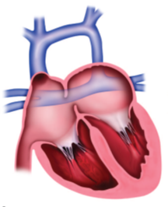
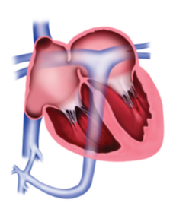
Total Anomalous Pulmonary Venous Connection
Supracardiac TAPVC
Infracardiac TAPVC
Notes:
Total anomalous pulmonary venous connection (TAPVC) is a defect in the normal connection of the embryologic pulmonary venous buds to the posterior aspect of the developing left atrium
The result is pulmonary venous return to the right atrium via systemic venous connections
TAPVC is classified according to the site of connection of the anomalous draining vein(s):
supracardiac,most commonly to the left brachiocephalic vein from a left vertical vein but also to the right or left superior vena cava or azygos vein
cardiac, drainage to the coronary sinus or right atrium
infracardiac, usually but not always below the diaphragm (inferior vena cava,portal vein, hepatic veins, or ductus venosus);
mixed, to more than one level
If the anomalous connection of the draining vein is obstructed, the patient tends to present as a neonate with pulmonary edema and hypoxemia
With supra- and infracardiac TAPVC, the anomalous draining veins tend to form a common venous chamber, or confluence, behind the heart
With supracardiac TAPVC, this common venous confluence drains via the left vertical vein to the left brachiocephalic vein, superior vena cava, or azygos vein
With infracardiac TAPVC, this common venous confluence drains via a descending vertical vein, generally terminating below the diaphragm
Cardiac TAPVC drains via the coronary sinus directly into the right atrium
Some degree of obstruction is always present when the drainage is infracardiac
A patent foramen ovale or an atrial septal defect (ASD) is always present in these patients, who are dependent on these lesions for systemic blood supply and survival. TAPVC may be associated with more complex anomalies, including heterotaxy syndromes

Slide 71
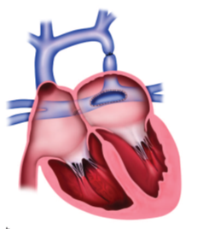
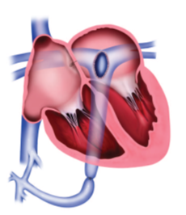
Notes:
The goal of surgical correction of TAPVC is
: to re-establish a normal connection of the pulmonary venous confluence to the left atrium
Anomalous systemic venous connections and intracardiac shunts are generally closed at the same time.
Repair may be performed by using an intracardiac approach, in which the pulmonary venous confluence is repaired through the right atrium, or an extracardiac approach, in which the venous confluence is anastomosed directly to the left atrium
When the anomalous drainage is cardiac (via the coronary sinus to the right atrium), the surgical technique generally involves an incision in the common wall shared by the coronary sinus and the left atrium, allowing the coronary sinus to drain into the left side of the heart
The entire defect is then closed with a pericardial patch much like an ASD would be repaired
For the repair of supra- and infracardiac TAPVC, an incision is made along the posterior wall of the left atrium and along the anterior wall of the common venous chamber, allowing free drainage to the left side of the heart
Early complications of TAPVC repair are usually related to increased pulmonary vascular resistance and pulmonary hypertension.
The major postoperative complication of repair of TAPVC is the development of late postrepair pulmonary venous stenosis,which occurs in up to 10% of repairs.
Surgical correction of this complication is associated with 30%–45% early mortalities

Slide 72
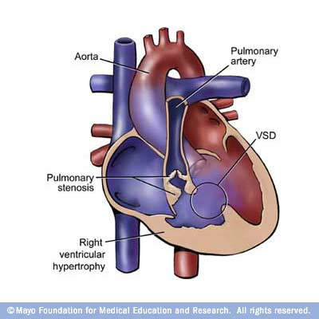
TOF
Étienne-Louis Arthur Fallot
Notes:
The classic lesions of TOF include pulmonary stenosis, VSD, overriding aorta, and right ventricular hypertrophy
The essence of the lesion is a VSD and right ventricular outflow tract (RVOT) obstruction that limits pulmonary blood flow
When RVOT obstruction is severe there is increased right-to-left shunting, resulting in increased cyanosis (blue tetralogy) . When the obstruction is less severe, the shunting is predominantly left–to-right (pink tetralogy).Some patients have complete obstruction of the RVOT and their condition is referred to as TOF with pulmonary atresia
This defect represents a spectrum from simple atresia of the pulmonary valve with intact main and branch PAs to absence of any normal PAs, with blood flow to the lungs coming from aortopulmonary collateral vessels

Slide 73
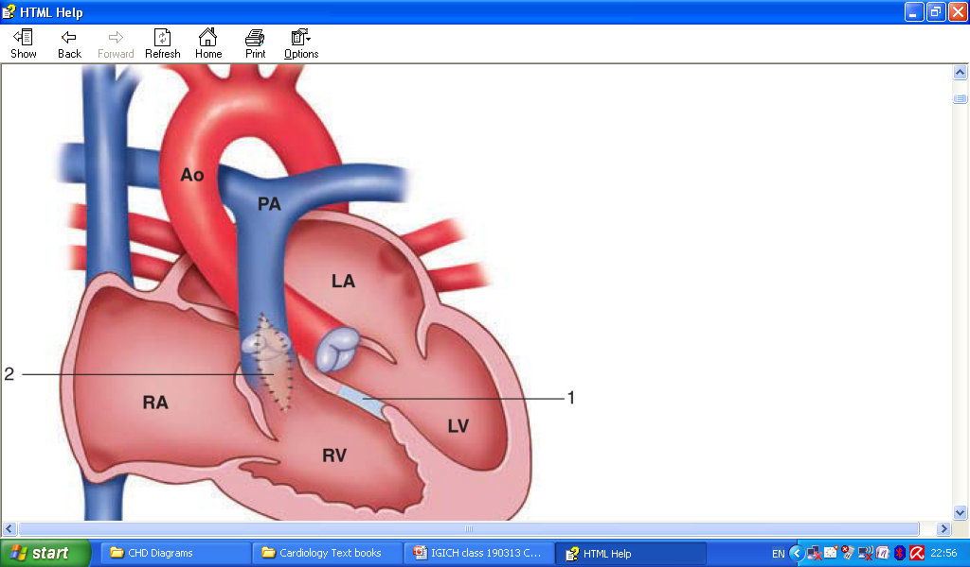
The goals for definitive TOF repair
  Closing the VSD
  Relieving the RVOT obstruction
Notes:
The first repair of TOF was performed more than 50 years ago by C. Walton Lillehei at the University of Minnesota
Originally pulmonary blood flow was augmented with a modified Blalock-Taussig shunt and definitive repair was undertaken when the child was older
More recently primary complete repair at 3–6 months of age is favoured by most programs with great success
Primary definitive repair prevents multiple scars and anesthetics and potential distortion of the PAs by the shunt
Both strategies, however, are acceptable

Slide 74
TOF (a) before repair, (b) after transannular patch repair in which VSD has been repaired through right ventricular incision, and (c) after transatrial/trans–pulmonary valve repair in which VSD has been repaired through right atrial incision
Notes:
Early techniques for repair of TOF included transannular repair
This involved closing the VSD through a large right ventricular incision and usually pulmonary valvectomy
With this repair the patient is left with a large section of dyskinetic right ventricle and with free pulmonary valve insufficiency
This has resulted in a large number of patients requiring subsequent pulmonary valve replacement
Currently, a premium is placed on efforts to spare the pulmonary valve and avoid a large ventriculotomy
Often the VSD can be closed via the right atrium and the RVOT obstruction by means of a simple pulmonary valvotomy with limited or no transannular incision. This is referred to as a transatrial repair
An anomalous left anterior descending coronary artery arising from the right coronary artery may cross the infundibulum of the right ventricle
A right ventricular incision should be not be performed in these patients to prevent injury to the coronary artery
In this scenario a right ventricle–to-PA conduit may be required to relieve RVOT obstruction

Slide 75
Complications
The patient may have pulmonary insufficiency
Residual pulmonary stenosis and a hypertrophied right ventricle
Eventually result in severe right ventricular dysfunction and heart failure in the majority of patients
Placement of a pulmonary valve will relieve heart failure symptoms and improve right ventricular hemodynamics

Slide 76
TOF with pulmonary atresia
Surgical repair is undertaken in the neonatal period
The VSD is closed via a right ventriculotomy
By using the same ventriculotomy a right ventricle–to-PA conduit is placed
  Traditionally by using a valved aortic or pulmonary homograft
Eventually outgrow their conduits and require repeat surgery
Notes:
TOF with pulmonary atresia (which some classify together with pulmonary atresia with VSD) can range from simple atresia of the valve to complete absence of the pulmonary arteries, with pulmonary blood flow via aortopulmonary collateral vessels
These collaterals provide a spectrum of blood supply to the lungs that ranges from direct connections to the PAs, to supply at the arteriolar or capillary level, to the formation of a discrete and separate blood supply to the lungs without communication with the Pas
Those infants with simple valve atresia have few collateral vessels and are ductal dependent; they present with severe cyanosis when the PDA closes
Patients with substantial collateral vessels can be relatively free of symptoms
These patients may develop signs of congestive heart failure, with increasing collateral flow, or over time may develop pulmonary hypertension from pulmonary blood supply at arterial pressures
The goal of surgical repair of TOF with pulmonary atresia is to re-establish continuity between the right heart and the PAs, which is essential for PA and alveolar development

Slide 77
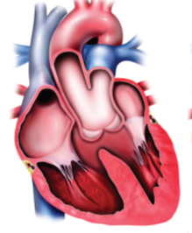
Truncus Arteriosus Repair
Resulting from failure of septation of the conotruncus into a separate aorta and PA
Notes:
The result is a single vessel arising from the heart, which supplies the systemic, pulmonary, and coronary blood flow, with at least one PA arising from this truncal artery
There is a single truncal valve, which may have a variable number of leaflets that may be stenotic or regurgitant
In more than 80% of the patients, a large VSD is also present
Neonates with truncus arteriosus are generally asymptomatic while PA pressures remain elevated
Because both the pulmonary and the systemic blood flow arise from a single ventricular outlet however, patients tend to develop excessive pulmonary blood flow and congestive heart failure as PA pressures decrease in the 1st weeks of life
The increased pulmonary blood flow can cause pulmonary hypertension if not addressed in the first 3–6 months of life
Patients may occasionally develop retrograde flow in the abdominal aorta during diastole, causing steal phenomenon from the abdominal viscera

Slide 78
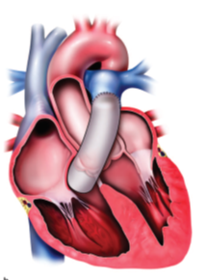
In 1968 McGoon described the first surgical repair of truncus arteriosus
The PAs separated from the aorta and a valve homograft placed from the right ventricle to the Pas
The VSD - closed at the same time
Notes:
Initially palliated with PA banding to limit pulmonary blood flow and prevent pulmonaryhypertension
This technique which is very similar to the Rastelli procedure remains the predominant method of repair of truncus arteriosus with typical use of a valved aortic or pulmonary homograft
Patients with abnormalities of the truncal valve may require repair or replacement of the valve
Children with successful repair of truncus arteriosus will require repeat operation to replace the right ventricle–to-PA conduit

Slide 79
Kawashima Operation
Used for anatomic correction of DORV-Taussig-Bing
The VSD serve as the mouth into a tunnel leading from the left ventricle through the right ventricle to the aorta
This tunnel occurs completely within the heart and is called an intracardiac conduit
This operation avoids the use of an extracardiac pulmonary conduit
Notes:
ventricle where both the aorta and the pulmonary artery originate from the right ventricle and the only exit from the left ventricle is the ventricular septal defect
This tunnel is created in such a way as to separate the LV to the aorta and the RV flow to the pulmonary artery

Slide 80
Cardiac Transplantation
The first successful infant heart transplant was performed by Leonard Bailey in 1985
Primary indications
  Irreparable congenital heart disease, failed repairs, cardiomyopathy
Other indications
  Intractable arrhythmias and some cardiac tumors
Notes:
Cardiac transplantation is indicated for a broad range of clinical problems in children
After this, cardiac transplantation became a common occurrence in patients with hypoplastic left heart syndrome
However, as hypoplastic left heart syndrome surgery (Norwood procedure) has become more successful, cardiac transplantation in infants is now generally reserved for those patients who have more complex defects or in whom traditional repairs have failed

Slide 81
cardiac transplantation
(a) after removal of recipient heart an (b) after placement of donor heart
Notes:
Current transplantation technique involves resection of the recipient heart, with a cuff of left atrium left behind at the insertion of the pulmonary veins. The great vessels are divided just above their respective valves. The right atrium can be partially resected, leaving behind the posterior wall with the superior and inferior vena cavae, or it can be resected entirely, dividing the superior and inferior vena cavae before their entry into the heartThe implantation process is simply a series of anastomoses

Slide 82
Complications
Infection
PTLD
Rejection
Graft coronary artery disease
Notes:
Infection is a notable cause of morbidity and mortality in pediatric patients after transplantation
In the 1st month following transplantation, bacterial and fungal infection are most common, resulting in pulmonary and sternal wound infections
Transplantation patients are particularly vulnerable to viral infections in the 6 months after surgery particularly cytomegalovirus and Epstein- Barr virus
Both are associated with increased risk of organ rejection
Epstein-Barr virus infection increases the risk of posttransplantation lymphoproliferative disorder (PTLD
PTLD includes a spectrum of disorders ranging from mononucleosistype illness to B-cell lymphoma, which are associated with Epstein-Barr virus infection after solid organ transplant. Because children are less likely than adults to have been exposed to Epstein- Barr virus prior to transplantation, they are at higher risk of primary Epstein-Barr virus infection after transplantation. Patients are particularly at risk for developing PTLD when the Epstein-Barr virus infection occurs within the first few months after transplantation. This primary infection could be the result of transmission from a seropositive donor to a seronegative recipient
Chronic rejection is associated with the development of graft coronary artery disease which is the leading cause of death among late survivors of cardiac transplantation
Graft coronary artery disease differs from typical atherosclerotic coronary artery disease in that it involves long segments of the coronary artery and is more difficult to treat with traditional angioplasty or bypass techniques
In addition because the heart is denervated and patients may be completely asymptomatic routine coronary angiography is mandatory
Evaluation of the coronary arteries with CT angiography has been promising in early investigations

Slide 83
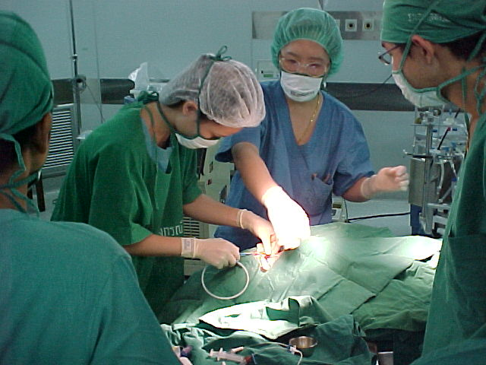
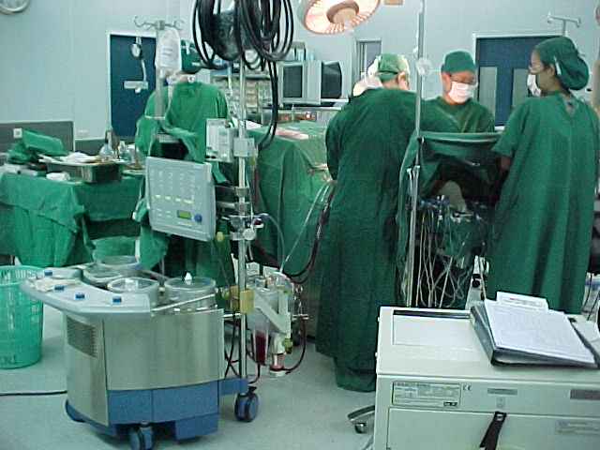
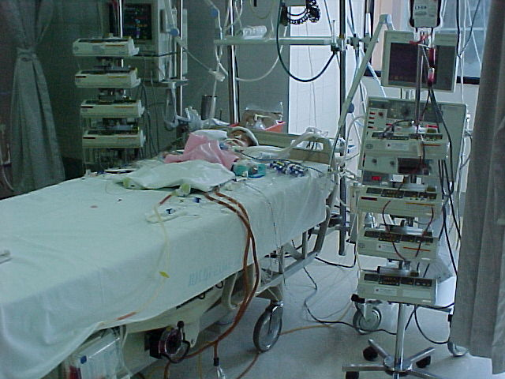
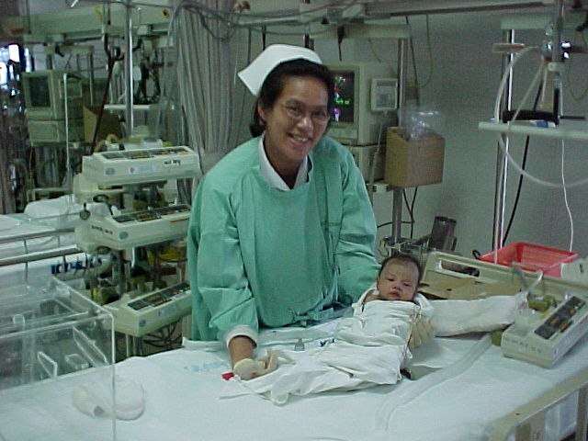
Notes:
The treatment of complex cchd need a lot of effort. Despite good equipment, it needs very good team include neonatal cardiologist, neonatal cardiac anesthetist, neonatal cardiac surgeon, well- trained scrub nurse, keen perfusionist, and keen ICU nurse.

Slide 84
Thank you

